Slide 1
CHAPTER 1 : KNOW YOURSELF
Know yourself –
Learn from peers

Slide 2

OBJECTIVES FOR THIS SESSION
Identify your strengths and interests
Reflect on what you have learned

Slide 3


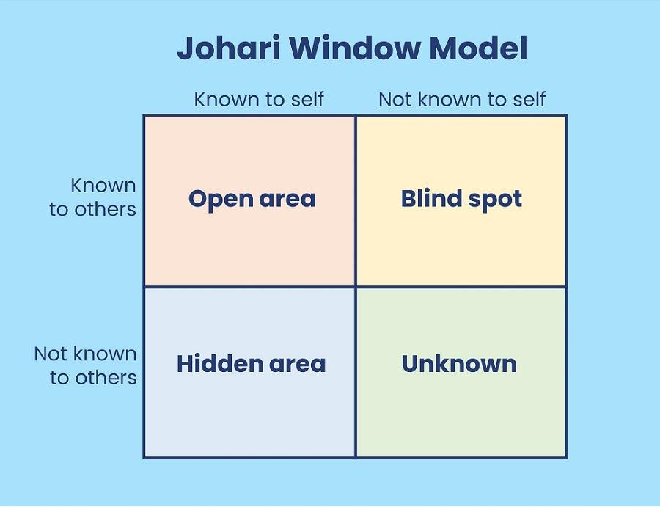
Johari Window
ACTIVITY 1
60 MIN
TO COMPLETE THIS ACTIVITY :
1
INDIVIDUAL WORK
2
DISCUSS IN TEAMS
(10 min)
(10 min per student)
Notes:
https://conceptboard.com/blog/johari-window-model/
https://www.youtube.com/watch?v=KdYo5jn29w4

Slide 4

ACTIVITY 2
Flesh your WIFI out
20 MIN
Open your WIFI Google Doc file
Clarify / Modify some ideas
Discuss with your peers: how
W Watch your interests
I Investigate your options
F Follow your dreams
I “I’m interested in _____ and I’ll see where it leads me.”
Notes:
Self reflection – What have I learned during those two sessions

